Slide 1
DEAD LOCK HANDLING

Slide 2
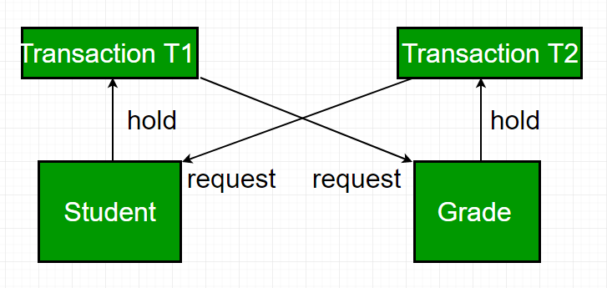
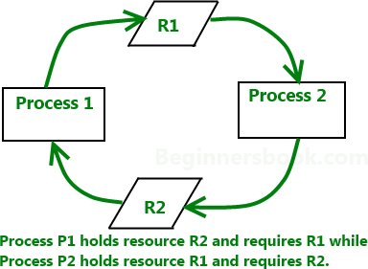
Dead Locks
A deadlock is a condition wherein two or more tasks are waiting for each other in order to be finished but none of the task is willing to give up the resources that other task needs.
In this situation no task ever gets finished and is in waiting state forever.

Slide 3
Dead Locks : Coffman’s Conditions of Dead Lock
Coffman stated four conditions for a deadlock occurrence.
A deadlock may occur if all the following conditions holds true.
Mutual exclusion
Hold and wait condition
No preemption condition
Circular wait condition

Slide 4
Dead Locks : Coffman’s Conditions of Dead Lock
Mutual exclusion condition:
At least one data item is mutually exclusive(non-sharable)
Hold and wait condition:
A transaction that is holding a data item and waiting for other resource, held by other transaction
No preemption condition: A data item cannot be forcibly taken from a transaction.
Circular wait condition:
A condition where one process is waiting for a resource that is being held by second process and second process is waiting for
third process ….so on and the last process is waiting for the first
process. Thus making a circular chain of waiting.

Slide 5
Dead Lock : Prevention
To prevent any deadlock situation in the system, the DBMS inspects all the operations, where transactions are about to execute. ... If it finds that a deadlock situation might occur, then that transaction is never allowed to be executed.

Slide 6
Dead Locks Prevention
Preventing one or more of four Coffman conditions could prevent the deadlock
Removing mutual exclusion:
1. All resources must be sharable

Slide 7
Dead Locks Prevention
Preventing one or more of four Coffman conditions could prevent the deadlock
Removing hold and wait condition:
if the process acquires all the resources that are needed
before starting out.
Enforce a rule of requesting resource when there are none in
held by the process

Slide 8
Dead Locks Prevention
Preventing one or more of four Coffman conditions could prevent the deadlock
Preemption of resources:
1. Preemption of resources from a process can result in rollback and thus this needs to be avoided in order to maintain the consistency and stability of the system.

Slide 9
Dead Lock: Prevention
Preventing one or more of four Coffman conditions could prevent the deadlock
Avoid circular wait condition:
This can be avoided if process can hold the resources in
increasing order of precedence
Force one resource per process rule – A process can request for a resource once it releases the resource currently being held by it

Slide 10
Dead Lock: Prevention
Deadlock prevention method is suitable for a large
databases
If the resources are allocated in
such a occurs, then the deadlock
way that can be
deadlock never prevented
The Database management system analyzes the operations of the transaction whether they can create a deadlock situation or not. If they do, then the DBMS never allowed that transaction to be executed.

Slide 11
Dead Lock: Prevention
Dead Lock Prevention Methods
Wait -Die
Wound - Wait

Slide 12
Dead Lock: Prevention
Wait-Die
If a transaction requests for a resource which is already held with another transaction then the DBMS simply checks the timestamp of both transactions.
It allows the older transaction to wait until the resource is available for execution.
Example :
Assume there are two transactions Ti and Tj let TS(T) is a timestamp of any transaction T
If T2 holds a lock by some other transaction and T1 is requesting for resources held by T2 then the following actions are performed by DBMS-

Slide 13
Dead Lock: Prevention
Wait-Die
Check if TS(Ti) < TS(Tj) - If Ti is the older transaction and Tj has held some resource, then Ti is allowed to wait until the data-item is available for execution. That means if the older transaction is waiting for a resource which is locked by the younger transaction, then the older transaction is allowed to wait for resource until it is available.
Time Line
Tj 5:36
Ti 5:34
Wait
Younger
Older
R1

Slide 14
Dead Lock: Prevention
Wait-Die
Check if TS(Ti) < TS(Tj) - If Ti is older transaction and has held some resource and if Tj is waiting for it, then Tj is killed and restarted later with the random delay but with the same timestamp.
Time Line
Tj 5:36
Ti 5:34
Die
Younger
Older
R1

Slide 15
Dead Lock: Prevention
Wound Wait
if the older transaction requests for a resource which is held by the younger transaction, then older transaction forces younger one to kill the transaction and release the resource. After the minute delay, the younger transaction is restarted but with the same timestamp
Time Line
Tj
Wounded 5:36
Ti 5:34
Younger
Older
R1

Slide 16
Dead Lock: Prevention
Wound Wait
If the older transaction has held a resource which is requested by the Younger transaction, then the younger transaction is asked to wait until older releases it.
Time Line
Tj 5:36
Ti 5:34
Wait
Younger
Older
R1

Slide 17
Dead Lock: Prevention
Wait/Die Wound/Wait
Older transaction needs a resource held by younger transaction Younger transaction needs a resource held by older transaction | Older transaction waits ^{Younger} transaction dies Younger Younger transaction dies transaction waits

Slide 18
Dead Lock: Detection
In a database, when a transaction waits indefinitely to obtain a lock, then the DBMS should detect whether the transaction is involved in a deadlock or not
The lock manager maintains a Wait for the graph to detect the deadlock cycle in the database

Slide 19
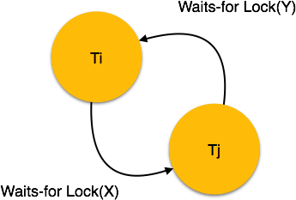
Dead Lock: Detection
Wait for Graph
Used for deadlock detection
A graph is created based on the transaction and their lock
If the created graph has a cycle or closed loop, then there is a deadlock.

Slide 20
Dead Lock: Avoidance
Check for deadlock at each step; If dead lock then abort or rollback transaction. disadvantage: waste of time and resource
Check for deadlock in advance of a transaction.
This method is suitable only for the smaller database.
For the larger database, deadlock prevention method can be used.

